Slide 1
It’s a Mystery
Deductive reasoning in literature, math, and science

Slide 2
History of the mystery
The first true mystery stories were written by Edgar Allen Poe. This was a result of countries with a rule of law organizing professional police forces to solve crimes on the basis of fact. Poe introduced the first elements necessary for a mystery novel:
1. An amateur detective whose exploits are chronicled by an admiring friend.
2. The locked room mystery
3. An innocent suspect in jeopardy
4. Careful detection through following clues fairly offered
5. A trap laid for the true villain
6. The solution through the efforts of the detective
7. The first series character

Slide 3
Over the next hundred years, many mystery authors made their mark in literature:
Sir Arthur Conan Doyle, G.K. Chesterton, Mary Roberts Rinehart, Agatha Christie, Dorothy Sayers, Ellery Queen, John Dickson Carr, and Dashiell Hammett
Lawrence Trent (Mystery Writer’s Handbook) says there are certain rules of a classic mystery:
There must be a crime and the reader must want to see its solution- he must long to see the mystery solved.
The criminal must appear reasonably early in the story. The villain must be evident for a goodly portion of the book.
The author must be honest and all clues must be made available to the reader. The reader must know everything the protagonist knows.
The detective must evert effort to catch the criminal and the criminal must exert effort to fool the detective and escape from him.

Slide 4
Literature
Mini-lesson: History of Mysteries and Elements of a Mystery. Post the elements of a mystery in the room.
Activating Activity: The Mysteries of Harris Burdick by Chris Van Allsburg. Read the introduction of the book with the class.
Display the pictures from the book to inspire students to come up with the story for the picture. Students can choose a picture of their own. They will write a short mystery to go with the picture.

Slide 5
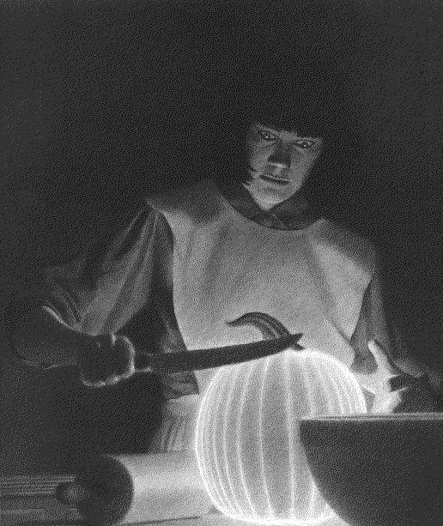
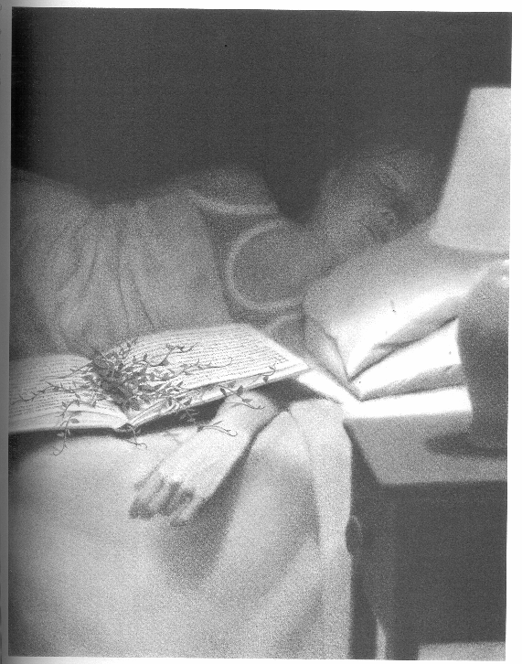
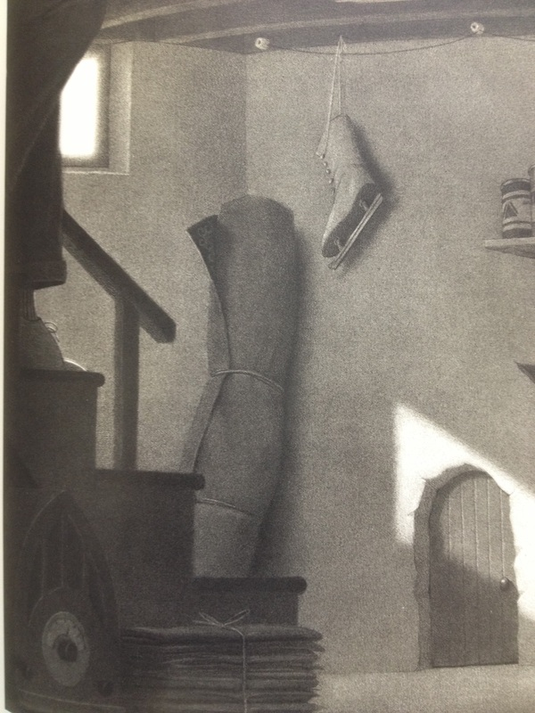
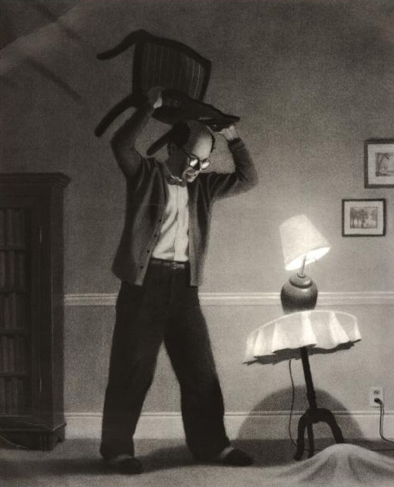
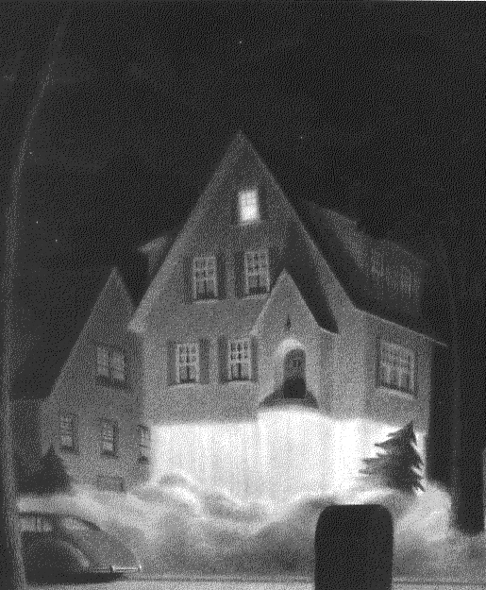
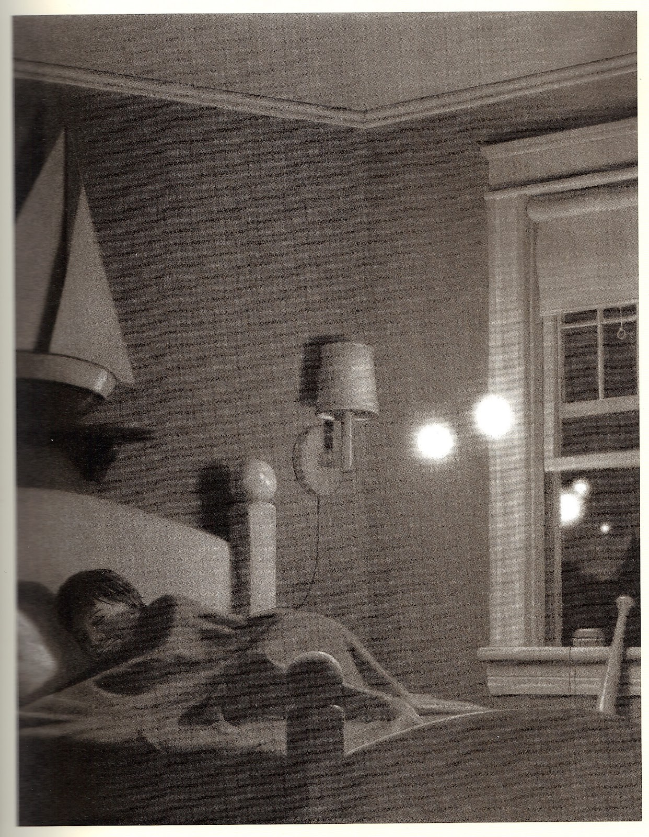

Slide 6
Other activities with mysteries:
1. Author study of a famous mystery author (see handouts). Students will research the author and then create a missing person’s report/ad for that author as the lead detective on the case. Provide choice (TV report, poster, fliers, milk carton, Emergency Alert system) on how to present their information on the missing author. Provide a list of possible authors, or give approval of student chosen mystery author. Requirements and rubric are included.
2. Choose several mystery authors (based on grade level) and a list of books from those authors. Students will read books independently, looking for evidence of mystery elements. Students keep a detective journal to keep track of information. Students will organize their notebook into sections to keep track of: Characters and descriptions, Settings, Clues (with page numbers). Distractions (red herrings), Plot, Conclusion, Evaluation (how would they improve the story? What would they add, take out, change to make the story better?)

Slide 7
Other activities with mysteries continued:
3. Five-Minute Whodunits by Stan Smith, Whodunit- You Decide! By Hy Conrad, Stories with Holes by Nathan Levy, Great Whodunit Collection by Jim Sukach. Introduce different mysteries to small groups and have them read and try to solve the mystery in 5-10 minutes. When giving their solution, groups must provide evidence to support their solution. “I know this because…” They can write their solutions if desired by the teacher. Can be done every day as a deductive reasoning activity.
4. Mystery Theater- go to www.merrimysteries.com and select a mystery reader’s theater for you age group and area of interest. Have students dress up as the characters from the mystery and act out the reader’s theater in class. We did Who Stole the Cookies from the Cookie Cupboard and had a brunch like Agatha’s: a Taste of Mystery in Atlanta. I made pancakes and the kids brought in toppings and syrup for the pancakes.
5. In-school field Trip: www.laughingmatters.com from Atlanta. They will do a mystery reader’s theater with your group no matter the size. All students get a part to play.

Slide 8
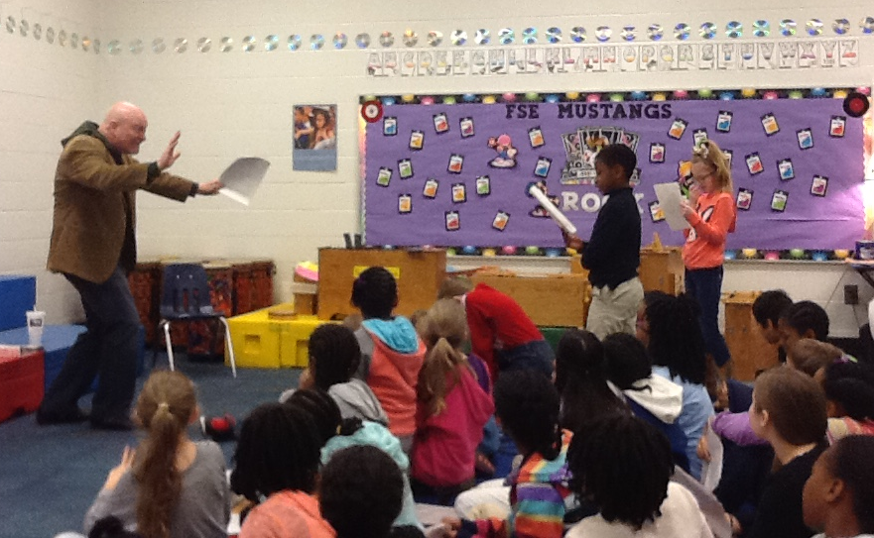
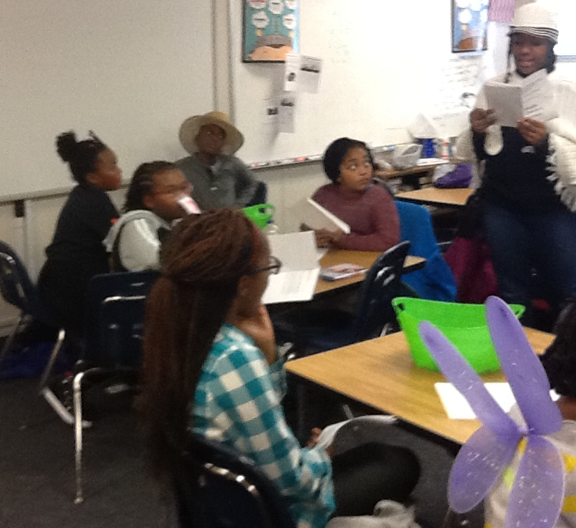
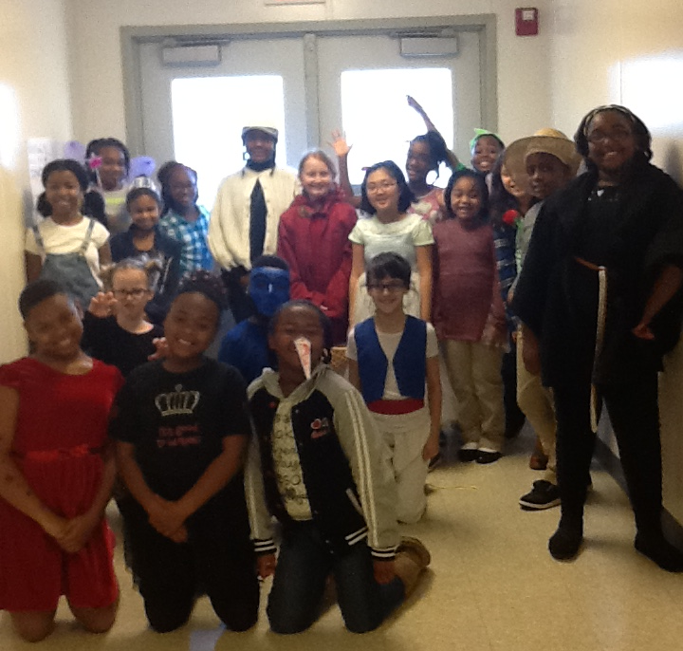
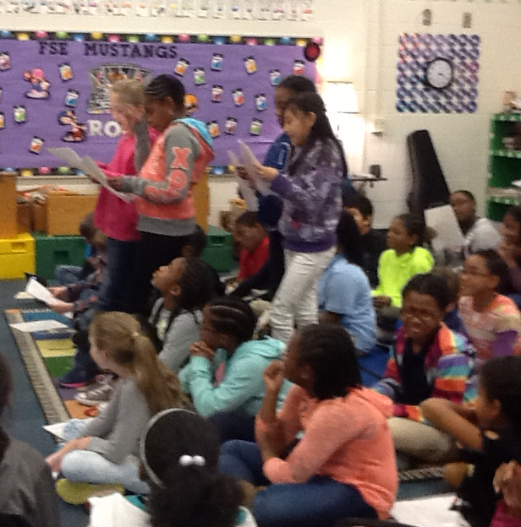
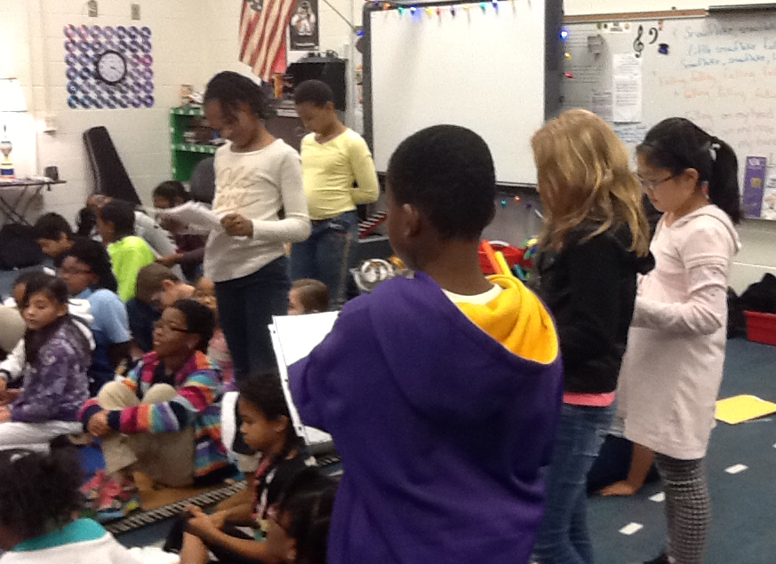
Who Stole the Cookies from the Cookie Cupboard? Mystery Theater Brunch
Laughing Matters In-School Field Trip

Slide 9
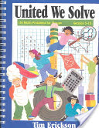
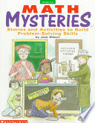
MATH
Problem solving and logical thinking using:
Exemplars.com (county subscription required)
Get it Together: Math Problems for Groups (Grades 4-12) by Tim Erickson
United We Solve: Math Problems for Groups (Grades 5-10) by Tim Erickson
Math Mysteries by Jack Silbert
Math Maven’s Mysteries (http://teacher.scholastic.com/maven/)
Marcy Cook math (K-8)
www.marcycookmath.com

Slide 10
From Logic Posters, Puzzles, and Problems
by Honi J. Bamberger Scholastic Teaching Resources

Slide 11
SCIENCE
Forensics: Get a Clue unit (interdisciplinary/grades 6-8, can be adapted for 5th grade) https://engage.intel.com/docs/DOC-51235
Crime and Puzzlement books by Lawrence Treat. Picture mysteries that require observation and analysis of clues. Can be used as an activating activity
Neo Science has many CSI related hands-on labs (Can be ordered through School Specialty) http://www.sciencelabsupplies.com/Neo-Sci.html
Forensic Science for Kids: CSI Expert (Grades 5-8) by Karen Schulz
Crime Lab Chemistry: Solving Mysteries with Chromatography
Mystery Festival (Grades 2-8) by Kevin Beals and Carolyn Willard
Fingerprinting (Grades 4-8) by Jeremy John Ahouse and Jacqueline Barber
(the last three are from here) www.lhsgems.org

Slide 12
Activating Activities
A great way to begin class is with an investigation activity. This gets students’ minds engaged and created an atmosphere of teamwork. Students can work together as a class or in smaller teams to solve a mystery, with one student as the moderator. The other students are investigators and try to ask questions that will lead to the solution. Students can earn points based on the amount of time it takes them to “crack the case”. The catch? The moderator can only answer Yes or No questions! There are only SEVEN responses a moderator can give to the investigators!
Now YOU will have an opportunity to try this game. Form a small group of 7-10. One person will be the moderator and receive The Case in a folder. The moderator will read the SEVEN responses they are allowed to give in answering questions to make sure all investigators try to word their questions correctly. They will then read The Case and The Mystery to the investigators. Moderators will turn over The Case card and quickly read The Solution and The Story so they can answer the investigators’ questions. Investigators will then begin asking questions- keep them going! Try to pay attention to the questions asked to help you organize the information. When you think you have The Solution, explain it to the Moderator. If you are correct, check the timer on the screen and note the time it took your group to solve The Case!

Slide 13
From the Milton Bradley game “Crack the Case”

Slide 14
Are you ready?
http://www.online-stopwatch.com/countdown-timer/

Slide 16
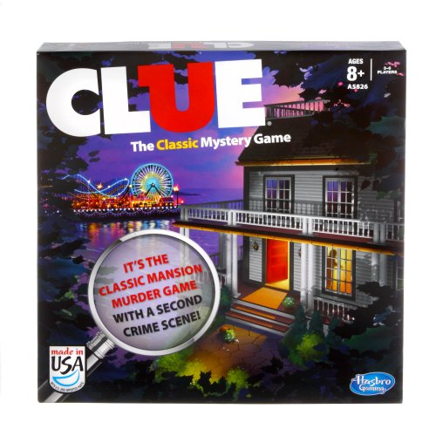
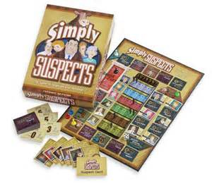
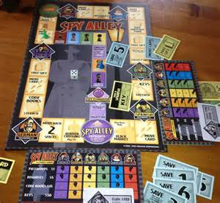
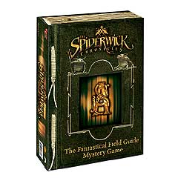
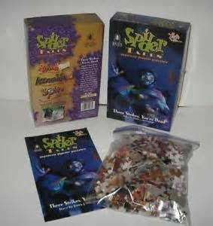
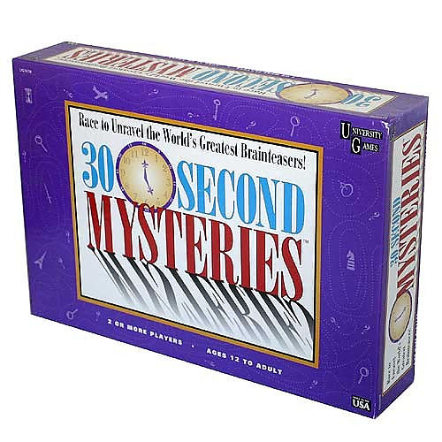
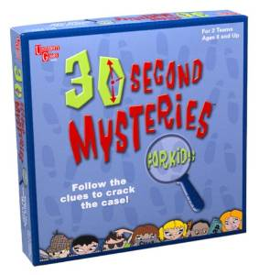
Other Games you can Play
Clue
Simply Suspects
Spy Alley
30 Second Mysteries/30 Second Mysteries for Kids
Spiderwick Chronicles Mystery Game
Spider Tales (mystery story/puzzle)

Slide 17
Other Resources
Writing Mysteries in the Classroom (Grades 5-8) by Cheryl Garrett
Mystery at Golden Ridge Farm: An Interdisciplinary Problem-Based Learning Unit (Grades 5-8) by Theresa Van Praet
One-Hour Mysteries (Grades 4-8) by Mary Ann Carr
Detective Club: Mysteries for Young Thinkers (Grades 2-4) by Judy Leimbach, Sharon Eckert
Math Logic Mysteries: Mathematical Problem Solving With Deductive Reasoning (Grades 5-8) by Marilynn L. Rapp Buxton
A Mathematical Mystery Tour: Higher-Thinking Math Tasks (Grades 5-12) by Mark Wahl
Mystery Science: The Case of the Missing Lunch (Grades 3-4) by Connie Gatlin
Mystery Science: The Case of the Missing Bicycle (Grades 3-4) by Diego Patino, Suzanna E. Henshon Ph.D.
Science Sleuths: Solving Mysteries Using Scientific Inquiry (Grades 6-9) by Howard Schindler, Dennis J. Mucenski
Crime Scene Detective: Using Science and Critical Thinking to Solve Crimes (Grades 5-8) by Karen K. Schulz

Slide 18
Still More Resources
http://dailybrainteaser.blogspot.com/2010/08/top-10-mystery-puzzles.html (online mysteries)
http://www.mysterymaster.com/puzzles/index.php (online grid logic puzzles)
http://www.mysterynet.com/ (mystery information, kids section of mysteries)
http://kids.mysterynet.com/
http://www.merrimysteries.com/ (scripts for mystery theater)
http://dramaticfanatic.com/mystery-party/ (scripts for mystery theater)
http://mymysteryparty.com/kids-mystery-parties/ (scripts for mystery theater)
Bella's Mystery Deck (ages 8-12) by Mindware (Illustrated mystery story cards)
Benjamin's Mystery Deck (ages 10 and up) by Mindware (illustrated mystery story cards)
Perplexors (levels vary; age 9+) by Mindware (logic puzzles)
Math Perplexors (levels vary; age 9+) by Mindware (math logic puzzles)
Grid Perplexors (levels vary; age 9+) by Mindware (grid logic puzzles)

Slide 19
Any Questions?????

Slide 20
If you would like further information, please contact us: Tanya Hampton thampton@rockdale.k12.ga.us Stephanie Tyler styler@rockdale.k12.ga.us Rockdale County Public Schools

